Slide 1
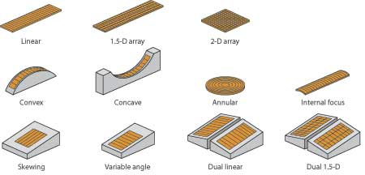
Two-Dimensional Imaging
TRANSDUCERS – CHAPTER 12

Slide 2

2D Imaging Difficulties
Characteristics of sound causes problems for 2-D imaging:
1. Sound travels in a straight line
2. Narrow beam is needed for optimal resolution
Multiple pulses overcome these problems.

Slide 3
Modern Systems
transmits a pulse into the body
listens
reflections are received
data is processed & stored
another pulse is transmitted at a slightly different angle
listens
reflections are received
data is processed & stored
process repeats until the entire sector image is completed
Notes:
For 90 pulses it takes 1/100 of a second

Slide 4
Each line is a separate pulse

Slide 5

What you will need to know about each type of transducer:
Shape and number of active elements
Automatic redirection of the sound beams to create an image (beam steering)
Methods of focusing for each beam
Shape of the two-dimensional image
Consequences of a damaged element or crystal

Slide 6
Mechanical transducer (old school!)
Scan head contains one active element that is physically moved
Crystals:
1 crystal
Disc or coin shaped
Steering:
Active element is moved by a motor, oscillating crystal or mirror through a pathway, automatically creating a scan plane.
Focusing
Conventional/fixed: curvature of the PZT or an acoustic lens focuses the beam at a specific depth
1. internal focusing (curved crystal)
2. external focusing (acoustic lens)
Focusing occurs in vertical and horizontal planes

Slide 7
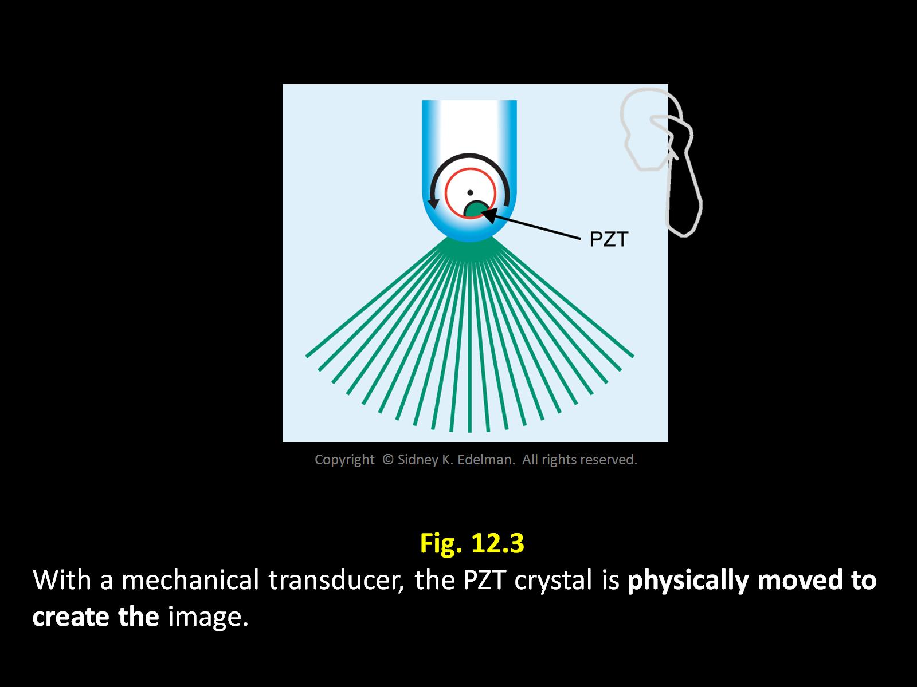

Slide 8
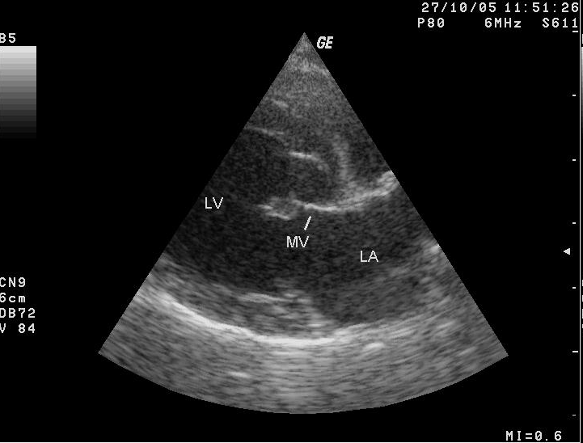
Mechanical Scanning
Image shape:
sector
Defective crystal:
destroys entire image

Slide 9
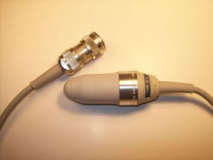
Mechanical Transducers

Slide 10

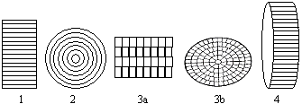
Array Transducers - Modern
Multiple active elements from a single PZT cut into separate pieces
Each element has a wire to its own electronic circuitry
Channel is the combination of
1. an active element
2. wire
3. system electronics

Slide 11
Types of Array Transducers
TYPE | ARRANGEMENT
Linear | Active elements are in a straight line
Annular | Elements are arranged as circular rings with a common center
Convex | Active elements are arranged in a bowed (arched) line; Also called a curved or curvilinear

Slide 12
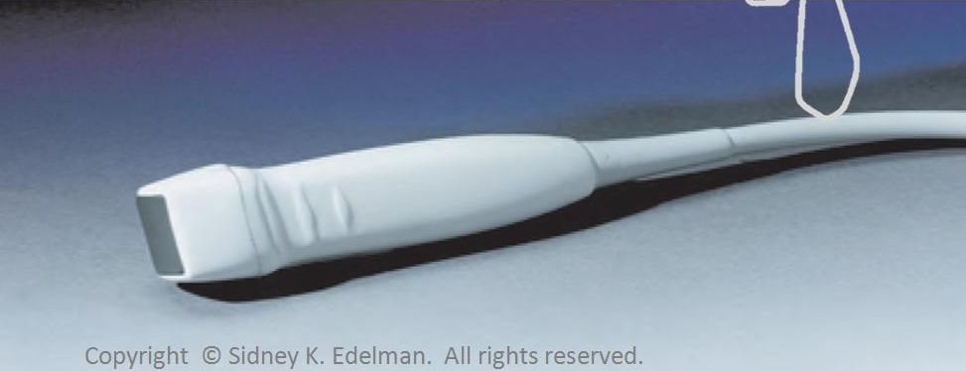
Linear Phased Array
Compact with a small footprint. (footprint is the face of the transducer that comes into contact with the skin)
Transducer is generally square shaped
Crystals:
100-300 elements arranged along the face of the probe.
Placed side by side
Each element is a narrow rectangle

Slide 13
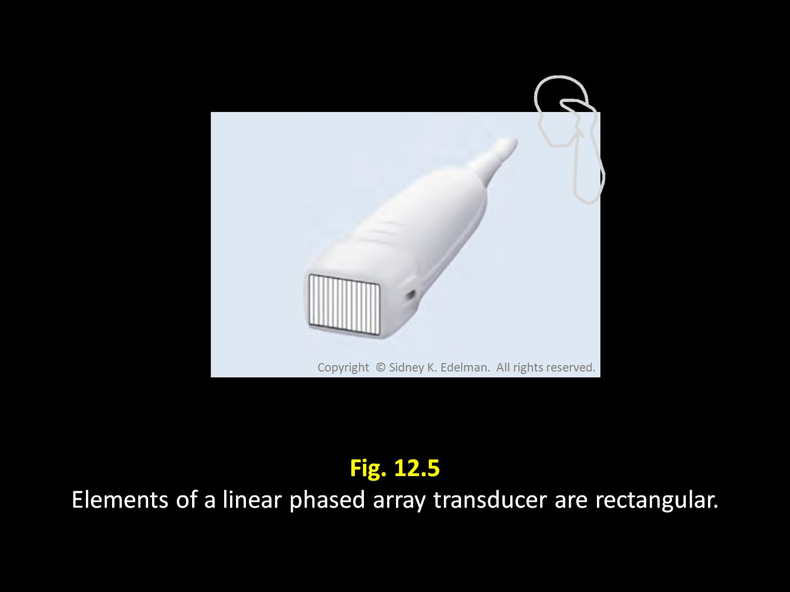

Slide 14
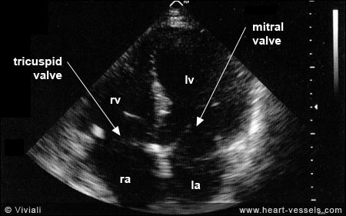
Linear Phased Array
Image shape: fan or sector shaped image
Beam Steering: image is built with an electronic steering process called phasing.
Sound beams are electronically transmitted in different directions without use of moving parts

Slide 15
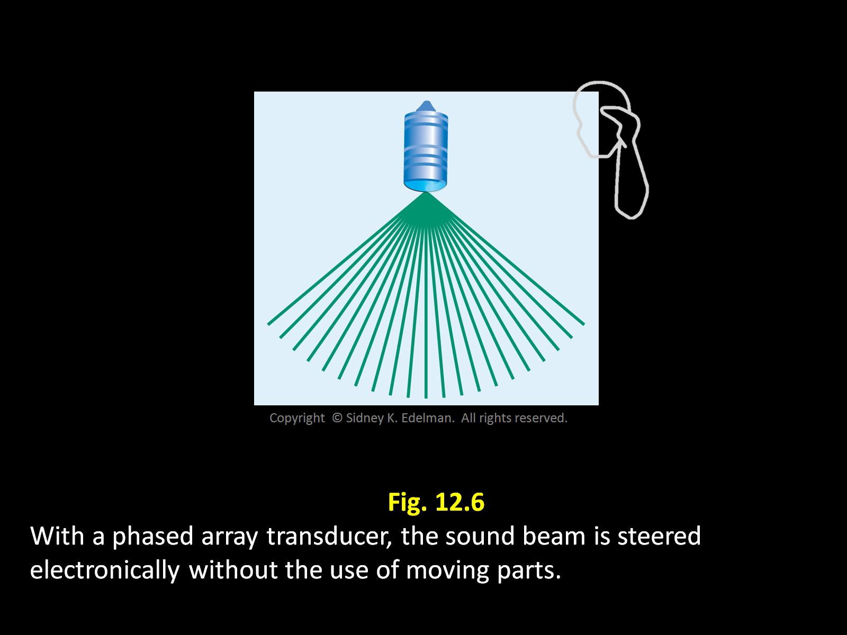

Slide 16

Linear Phased Array
Beam Focusing:
Focused electronically
Sonographer can modify the depth and amount of focusing of the sound beam
Multi-focusing capability
Can transmit multiple beams down the same scan line
Damaged crystal:
Inconsistent or erratic beam steering and focusing.
Cannot effectively be determined by looking at an image.

Slide 17
Linear Phased Array
All elements must be fired to create each sound beam
64 channels all are excited and result in 64 small wavelets
They interfere constructively and destructively creating a single sound pulse with specific characteristics.
The overall pattern of the electrical signals from the u/s system determines the sound beam’s direction & focus.

Slide 18
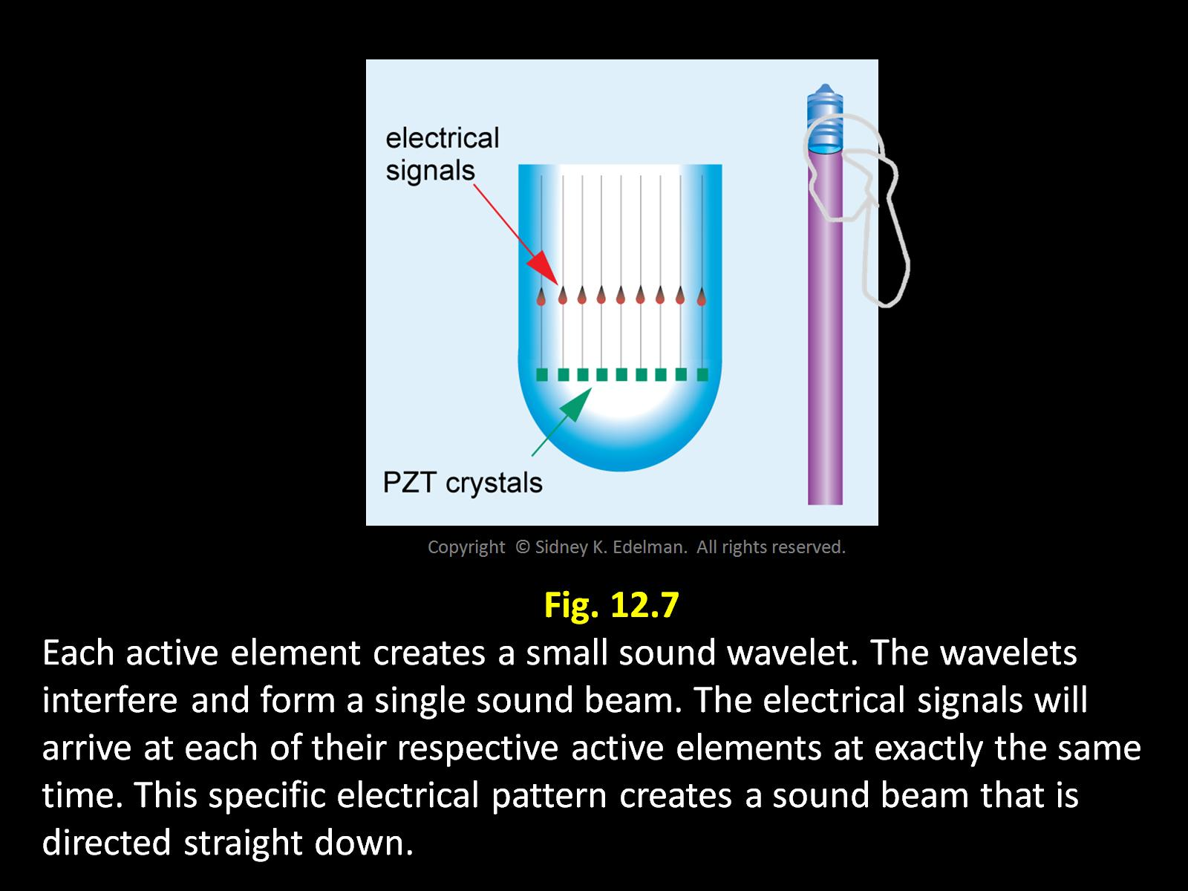

Slide 19
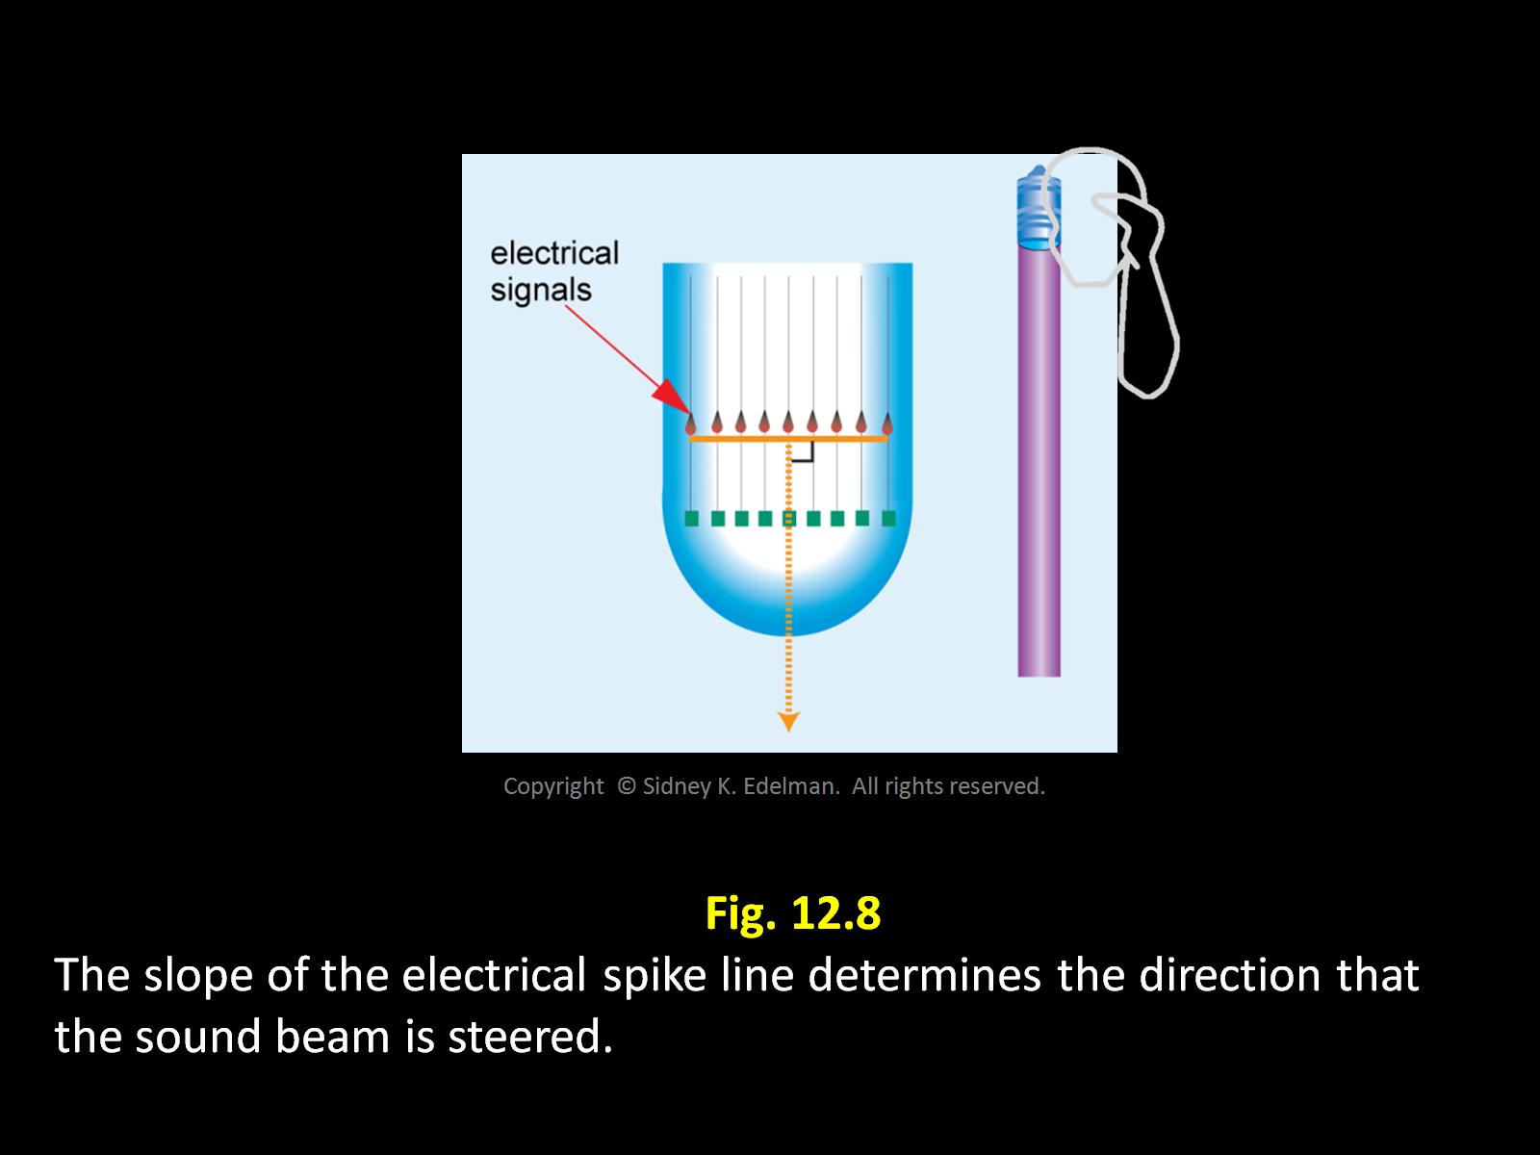

Slide 20
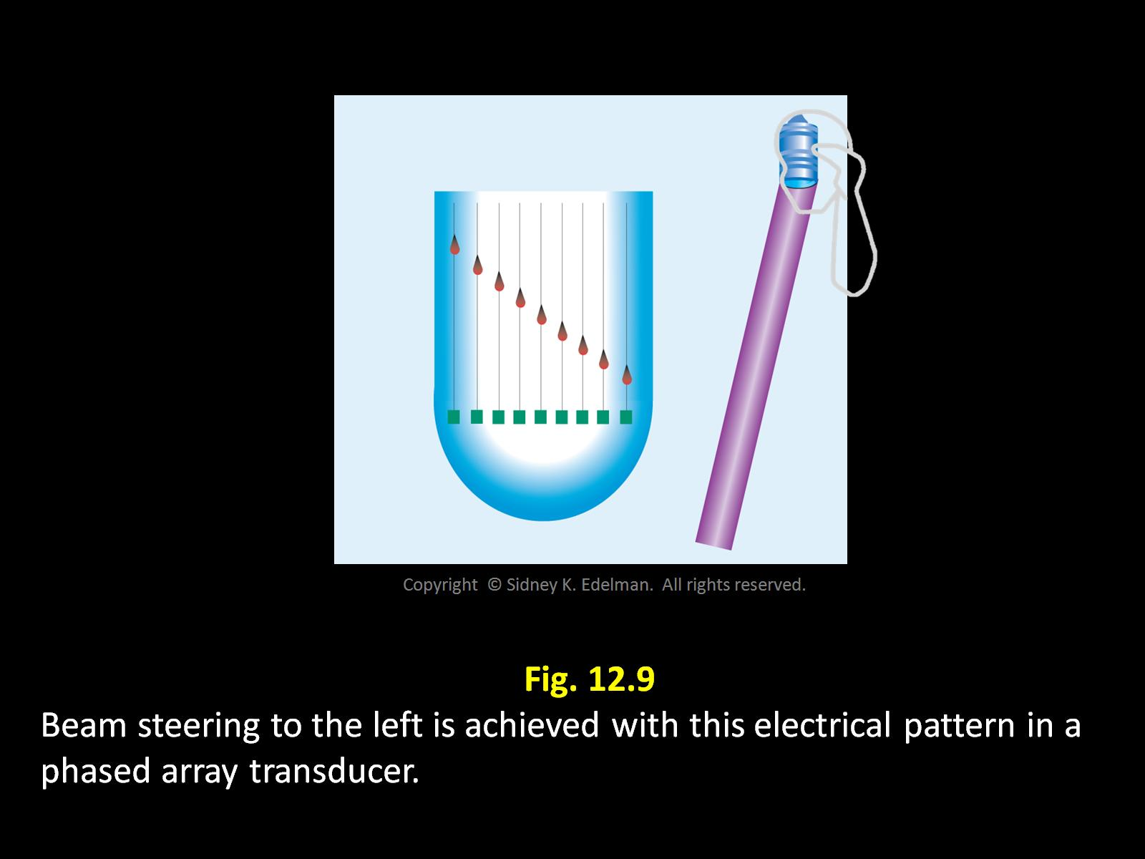

Slide 21
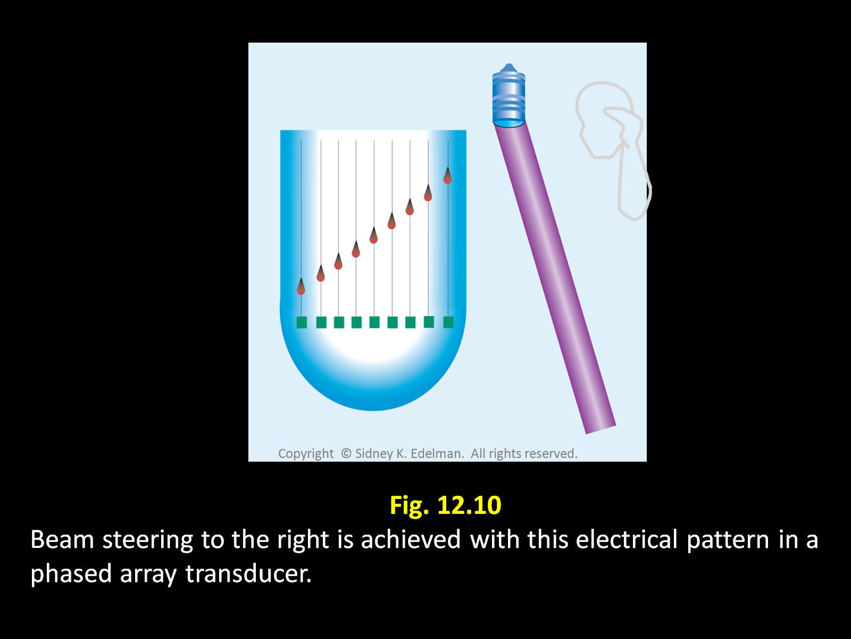

Slide 22
Beam Former
Creates the electronic firing patterns for a phased array
If the spiked line is straight , the sound beam created is an unfocused beam.

Slide 23
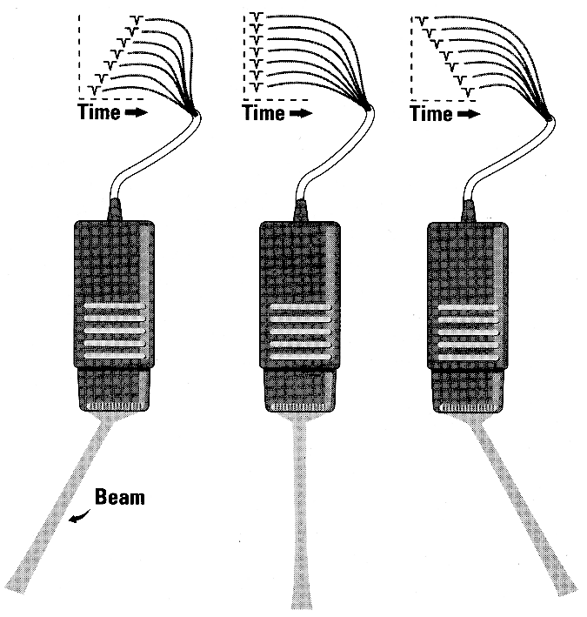
These beams
have straight
spiked lines
and are all
unfocused.

Slide 24
Transmit Focusing with Linear Phased Array
A focused beam is created when the electrical pattern is curved
A shallow or deep focus is created simply by altering the electricity (changing the curved pattern) emanating from the beam former

Slide 25
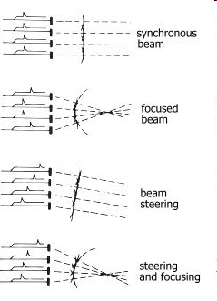
How do I figure it out?
If a firing pattern has a slope, then the beam is steered
Draw a line along the firing pattern of the beam.
Draw another horizontal line out from that pattern and that will display the direction of steering.

Slide 26
If the firing pattern is curved, then the beam is focused.
If the firing pattern is curved and has a slope, then the beam is steered and focused.

Slide 27

Phasing and Focus

Slide 28
Sound beam directed straight line
Focused Beam
Beam steered downward
Beam focused and steered downward

Slide 29
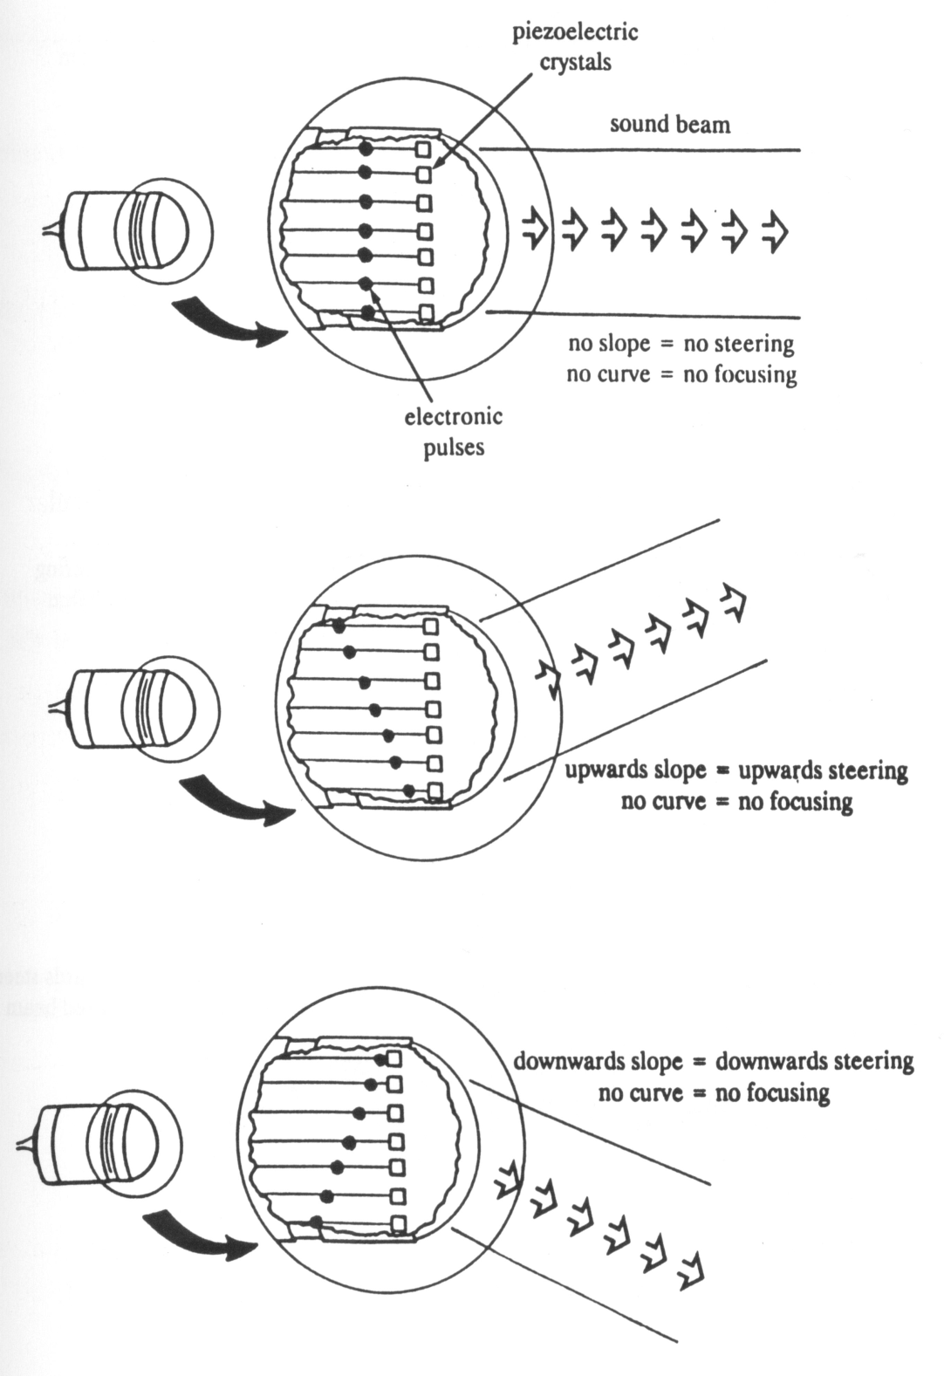
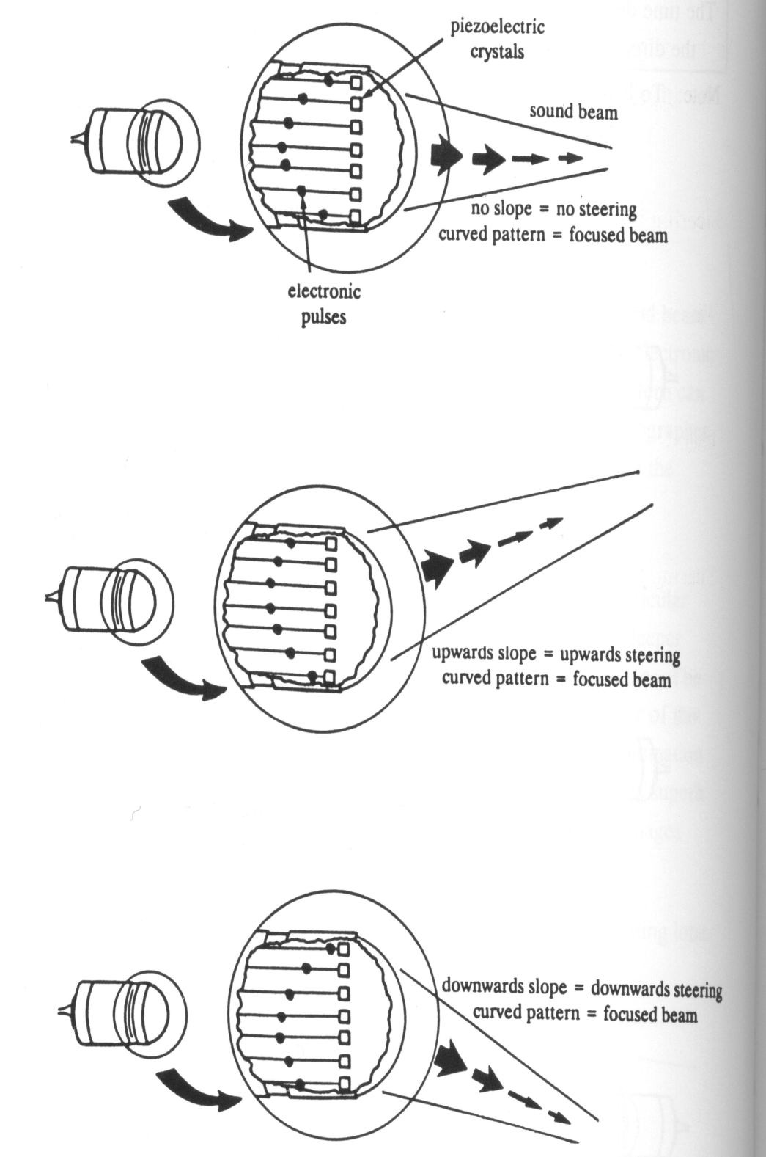
Note the differences:
No Steering
Steering & Focusing
Steering

Slide 30
Linear Phased Array
Electronic Pattern | Sound Beam
Slope | Steering
Curvature | Focusing

Slide 31
Multiple Transmit Linear Phased Array
A sound beam has a single focus
To create an image with multiple foci at different depths the system must send multiple sound beams down each scan line.
For 3 focal points each scan line must have 3 separate pulses, one for each focal zone

Slide 32

Dynamic Receive Focusing
AKA dynamic aperture
(performed by the machine)
As the returning sound beam strikes the transducer, the size of the transducer surface listening for echoes is varied.
This is accomplished by varying the number of elements used to receive the reflected signal

Slide 33
Dynamic Receive Focusing
Echoes arising early (from superficial structures) are received using only a few crystals from the array.
As echoes return from deeper structures, the aperture is increased. More and more elements are used to listen.
This optimizes our image quality

Slide 34
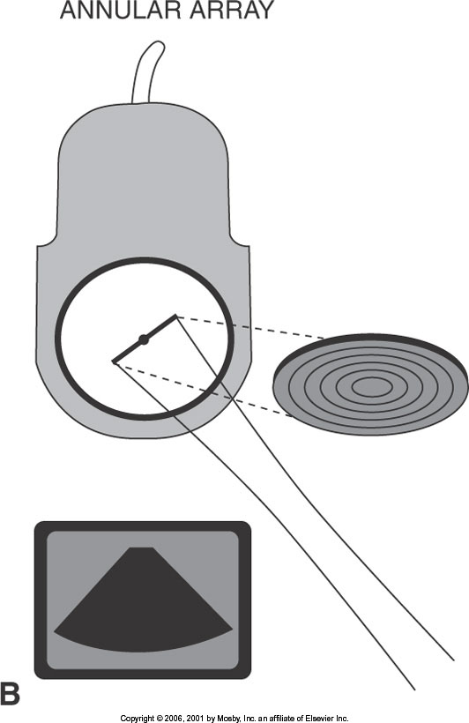
Annular Phased Arrays
There are multiple ring-shaped elements with a common center.
Beam Steering – is mechanical
Beam Focusing – multiple transmit focal zones

Slide 35
Annular Phased Arrays
Multiple transmit focus
The inner, smaller elements create near field focus
The larger elements create the far field focus
By using all the elements multiple transmit focal zones are created
*REMEMBER- smaller diameter crystals create shallow focus beams , while larger diameter crystals create deeper focus beams.

Slide 36
Annular Phased Arrays
Image Shape: Fan or sector shaped
The final image is a composite from only the focal zone of each crystal
Damaged PZT will create a horizontal image loss at a depth consistent with the damaged PZT, unlike a single element that might not show any image at all

Slide 37
Linear Sequential Arrays
Crystals:
120 to 250 rectangular strips of PZT material located side by side
Each PZT is about l wavelength in width
Beam Steering:
The elements are fired in groups
The first 5 then 6-10 then 11-15 and so on

Slide 38
LINEAR SEQUENTIAL ARRAYS
Beam Focusing:
Originally focused with a lens in front of the elements resulting in a fixed focus
Modern equipment are electronically focused

Slide 39
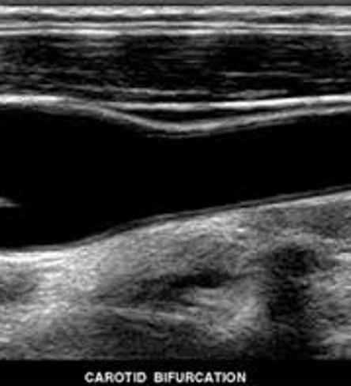
Linear Sequential Arrays
The image shape is rectangular and never wider than the footprint of the transducer

Slide 40
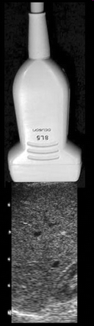
Linear Sequential Arrays
Damaged crystals create a loss of image in the line that the elements are damaged

Slide 41
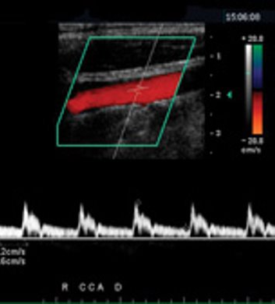
Linear Sequential Arrays
These images can be steered electronically creating a parallelogram shaped image
Beam formers of phased array systems steer sound beams by introducing sloped –shaped delays in the electrical excitation spikes.
Often used in vascular imaging to create a better reflector or to angle correct for spectral or color Doppler

Slide 42
Convex, Curved or Curvilinear Array
These are basically linear transducers, but they have a curve

Slide 43
Convex, Curved, Curvilinear Array
120 to 250 rectangular strips of PZT material located side by side
Each PZT is about l wavelength in width
In convex sequential arrays some but not all crystals are fired simultaneously to create a single sound beam.
The beams are directed straight out but are not parallel due to the arc.

Slide 44
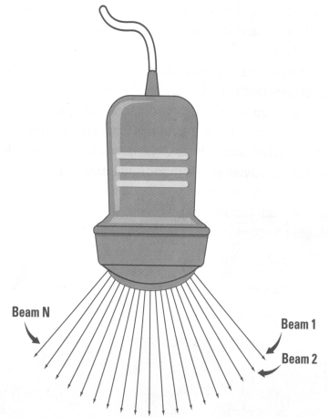
The superficial region does not have a point. It is broad and curved.

Slide 45
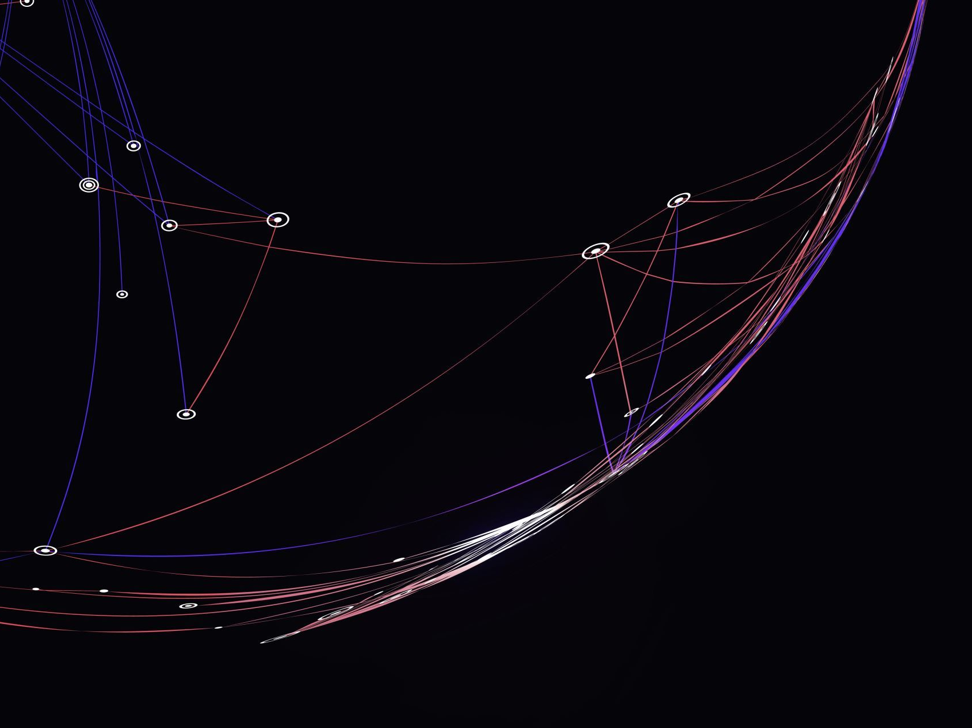
Convex, Curved, Curvilinear Array
Focusing is done electronically.
Transmit focusing is done by exciting the elements in the fired groups with an appropriate delay for the curved line pattern
Dynamic receive focus uses electrical delays in the returning signals
Image shape: blunted sector shape
Damaged crystals create a loss of image in the line that the elements are damaged

Slide 46
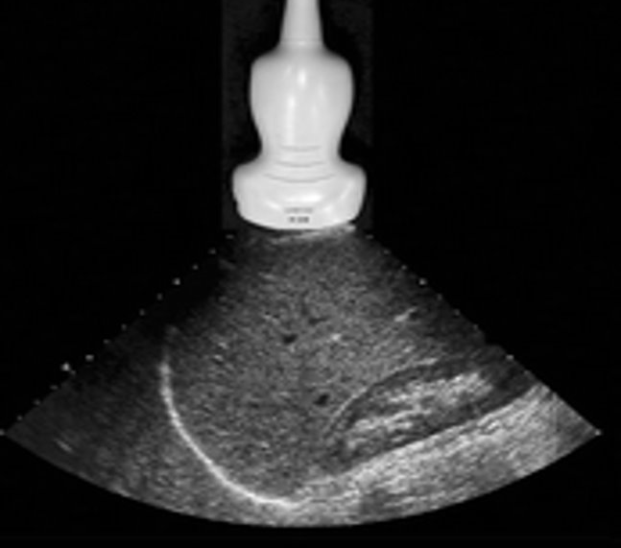
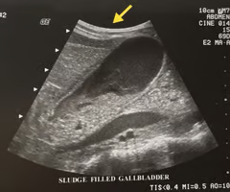
Convex, Curved, Curvilinear Array
Image shape: blunted sector shape
Damaged crystals create a loss of image in the line that the elements are damaged

Slide 47
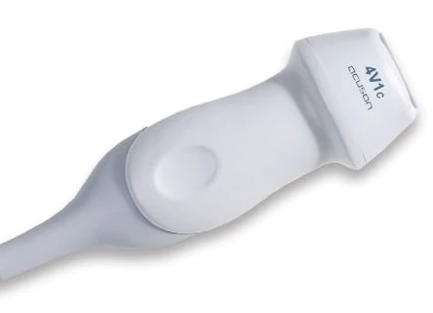
Vector Arrays
Combines linear sequential and linear phased array technologies
Sloped electrical delays create the virtual sector
There are 120 to 250 rectangular strips of PZT material located side by side with the footprint often being rather small

Slide 48
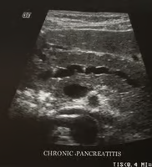
Vector Arrays
Beam focusing is similar to phased array transducers
The electronic transmit focusing and dynamic range focusing improves the image quality
The image shape is a trapezoid unlike curved array images the near field is flat

Slide 49

Slice Thickness or Elevational Resolution
Axial and lateral resolution affects image quality
Slice thickness also contributes to image quality
Image resolution in reality deals with three-dimensional space
shallow to deep
side-to-side
above-to-below the imaging plane
Notes:
2 aka elevation resolution

Slide 50
Slice Thickness or Elevational Resolution
Element shapes affect this resolution
Disc shapes have the thinnest plane within the focal zone.
*Found in mechanical and annular phased array transducers
*Have equal resolution in all planes
Notes:
1
2 found in mechanical annular and phased array transducers
they have equal resolution in all planes

Slide 51

Slice Thickness or Elevational Resolution
Measured perpendicular to imaging plane
The beam has a measurable thickness that varies with depth.
Structures that are in the edges of the plane can create reflection that are demonstrated on the final image
Notes:
3 this can degrade the image

Slide 52

Slice Thickness or Elevational Resolution
For most linear, curved, and phased arrays the electronic focusing is for IN-PLANE width of the beam.
An acoustic lens is used to create a thinner slice.

Slide 53
Slice Thickness or Elevational Resolution
With rectangular elements phasing focuses the beam
This narrowing improves lateral resolution but not slice thickness
With regard to resolution, axial is best, then lateral, followed by elevational

Slide 54
1½ Dimensional arrays
Some modern transducers have improved slice thickness creating thinner beams by altering the single PZT to multiple crystals
This changes the PZT number
Might be 700: 7 rows high by 100 wide

Slide 55
3-Dimensional imaging (3d)
2D array with thousands of elements arranged in checkerboard pattern
Electronically focused in both lateral and thickness planes
Electronically steered
4D= 3D in motion

Slide 56

Rendering
Creates an image from 3D data and provides an element of realism to the image
Constructs photo-like pictures with color, shadows, texture and optical effects.
Images are computer generated

Slide 57
Side Lobes
Side lobes are areas of sound at depths = or > the focal zone outside the main beam
Created by single element, mechanical transducers
The reflections can degrade the lateral resolution when they have enough energy
Notes:
Created from mechanical sectors

Slide 58
Grating Lobes
Grating lobes are created by array transducers
Off axis beams degrade lateral resolution

Slide 59
Apodization
The process that reduces the strength of grating lobes
Accomplished by varying the intensity of the electrical signals sent to the crystals

Slide 60
Subdicing
Crystal is divided into a group of smaller crystals- sub-elements
Electrically joined
Act as a single crystal reducing sidelines

Slide 61

Dynamic Aperture, Variable Aperture
Technique that narrows the beam over a greater depth range and optimizes lateral resolution
Accomplished by changing the number of crystals along the face of an array transducer probe used to transmit pulses or receive reflections.
Notes:
Resulting in improved lateral resolution
also call variable aperture
think of it as a listening hole - minimal elements used to receive reflected echoes

Slide 62
Transducers Summary
Transducer type | Image shape | Steering technique | Focusing technique | Crystal defect
Mechanical | Sector | Mechanical | Fixed | Image loss
Linear phased array | Fan or sector shaped | Electronic | Electronic | Inconsistent & erratic
Annular phased | Sector | Mechanical | Electronic | Horizontal line dropout
Convex sequential | Blunted sector | Electronic | Electronic | Vertical line dropout
Linear Sequential | Rectangular | Electronic | Electronic | Vertical line dropout
Vector | Trapezoid | Electronic | Electronic | Inconsistent & erratic

Slide 63
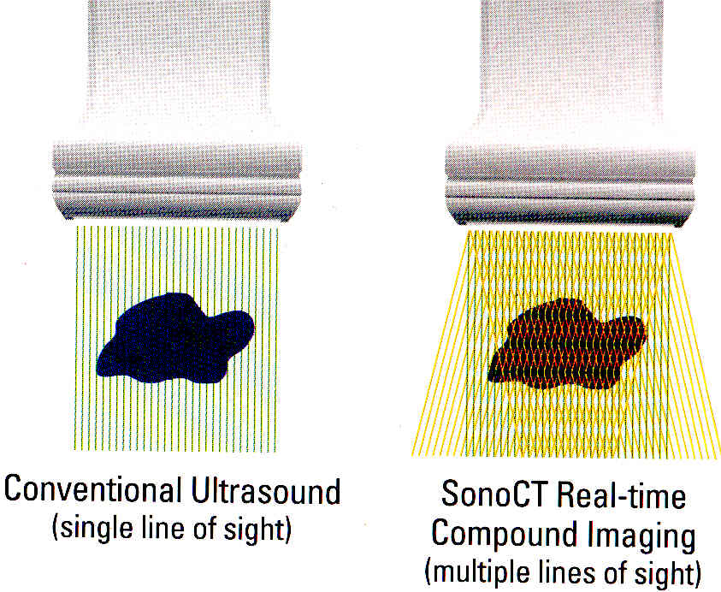
FYI

Slide 64
Matrix Array Transducers: Improve Spatial and Contrast Resolution
Breakthrough transducer technology
Elements arranged in rows AND columns
Enables beam forming in 3 dimensions
MA’s provide uniform beam thickness… uniform image consistency from near to far field

Slide 65
